Slide 1
Marketing Campaign Data Analysis using Excel
STUDENT NAME:K.LOGESH
REGISTER NO:422200015
DEPARTMENT:B.COM(ISM)
COLLEGE:S.I.V.E.T COLLEGE

Slide 2


Slide 3


AGENDA
Problem Statement
Project Overview
End Users
Our Solution and Proposition
Dataset Description
Modelling Approach
Results and Discussion
Conclusion
3/21/2024 Annual Review

Slide 4

PROBLEM STATEMENT
THE PROBLEM STATEMENT IDENTIFY THE CURRENT STATE,THE DISIREDFUTURE STATE AND ANY GAPS BETWEEN THE TWO.THE PROBLEM STATEMENT IS AN IMPORTANT COMMUNICATION TOOL THAT CAN HELP ENSURE EVERY ONE WORKING ON A PROJECT KNOWS WHAT THE PROBLEMTHEY NEED TO ADDRESSIS ANY WHY THE PROJECTIS IMPORTANT

Slide 5

PROJECT OVERVIEW
1.campaign goals and how you’ll measure them
2.your audience and what you know about them
3.creative requirements and key messages
4.responsibilities across the team

Slide 6

WHO ARE THE END USERS?
The end-user refers to the ultimate person who consumes a product or service. This term offers a sense of distinction between the individual who buys and makes use of goods or services, and the ones who design, develop, or manufacture the product. For developing an excellent product or service, the individuals who design, formulate, research, and promote the product or service should prioritize the preferences and needs of end-users, rather than their own. For instance, a tech programmer creating a special online platform trading multiple currencies would emphasize more on creating a user-friendly interface, and finding out what approach the end-user would follow.

Slide 7

OUR SOLUTION AND ITS VALUE PROPOSITION
A value proposition in marketing is a concise statement of the benefits that a company is delivering to customers who buy its products or services. It serves as a declaration of intent, both inside the company and in the marketplace.
The term value proposition is believed to have first appeared in a McKinsey & Co. industry research paper in 1988, which defined it as "a clear, simple statement of the benefits, both tangible and intangible, that the company will provide, along with the approximate price it will charge each customer segment for those benefits."1

Slide 8
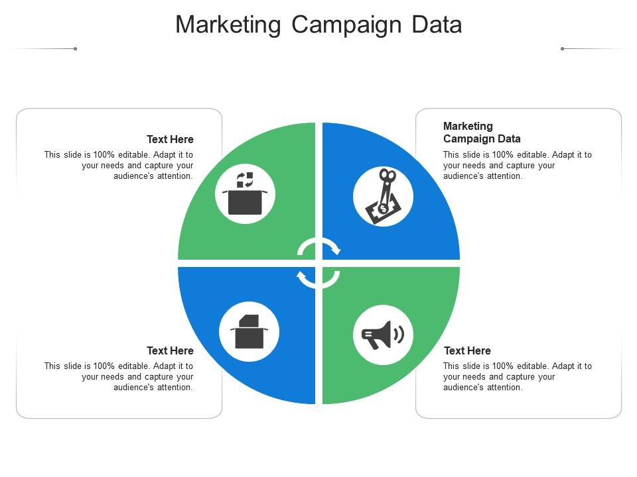
Dataset Description

Slide 9

THE "WOW" IN OUR SOLUTION
Strategy: Help make the health care system easier to navigate, and show people that they can easily use health care in everyday occurrences with money savings, time savings, and finding care.
Creative Direction: Connect with life instances that occur easily every day to show that health care is quite often about a simple every day occurrence like sunburn, and therefore everyone should know how to get care.
Creative Solution: Use images that instantly connect with people (e.g. puppy nibbles, kid hitting piñata) and connect people with the realization that there are Medical Billing Codes for nearly everything like, "Adverse Effects of Work Environment." The codes exist because they’re used, which is a risk for everyone.
3/21/2024 Annual Review
9

Slide 10
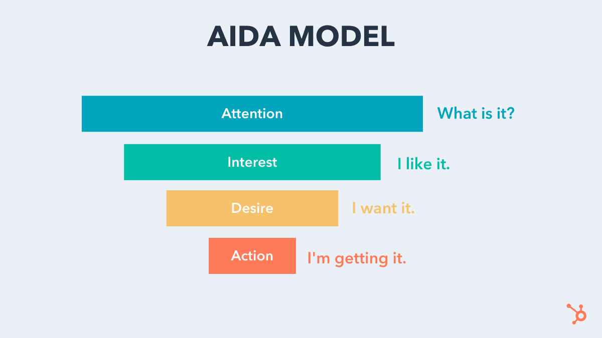
MODELLING
10

Slide 11
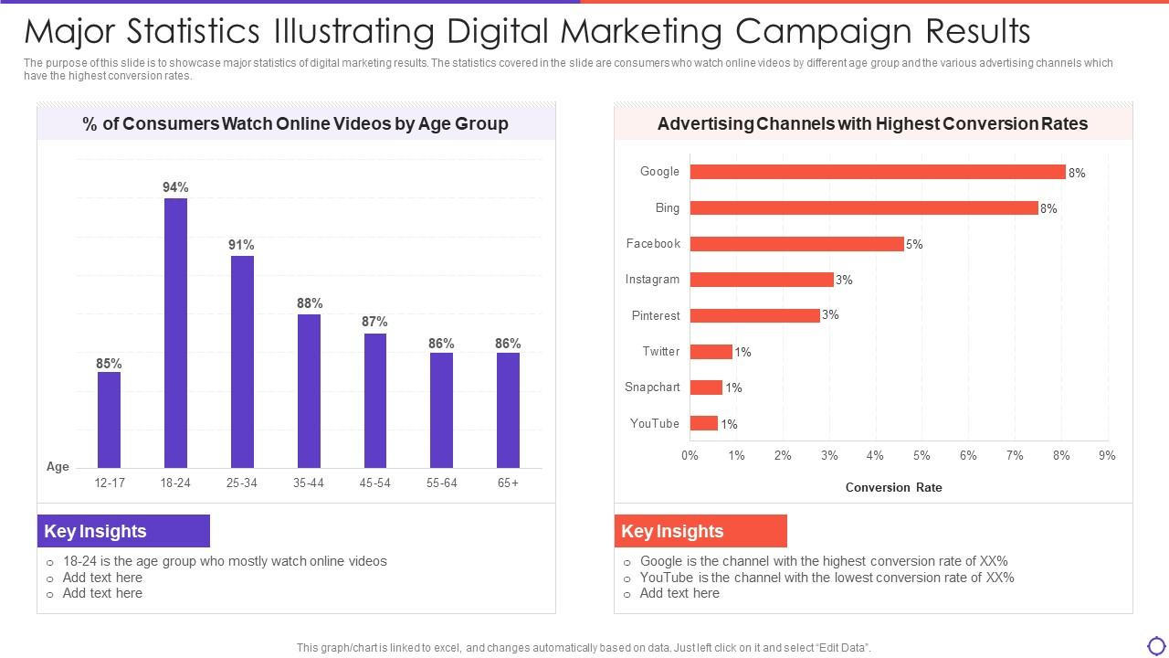
RESULTS
11

Slide 12
conclusion
which discusses marketing planning roles, the parts and functions of the marketing plan, forecasting, and the structure of a marketing plan audit. It also discusses PEST Analysis and other external factors that affect marketing decisions. This chapter reviews other concepts we've discussed so far. Key takeaways include the steps in the forecasting process. You will be able to identify types of forecasting methods and their advantages and disadvantages and discuss the methods used to improve the accuracy of forecasts. Lastly, you will apply marketing planning processes to ongoing business settings and identify the role of the marketing audit. Answer the discussion questions at the end of the chapter.

